Slide 1










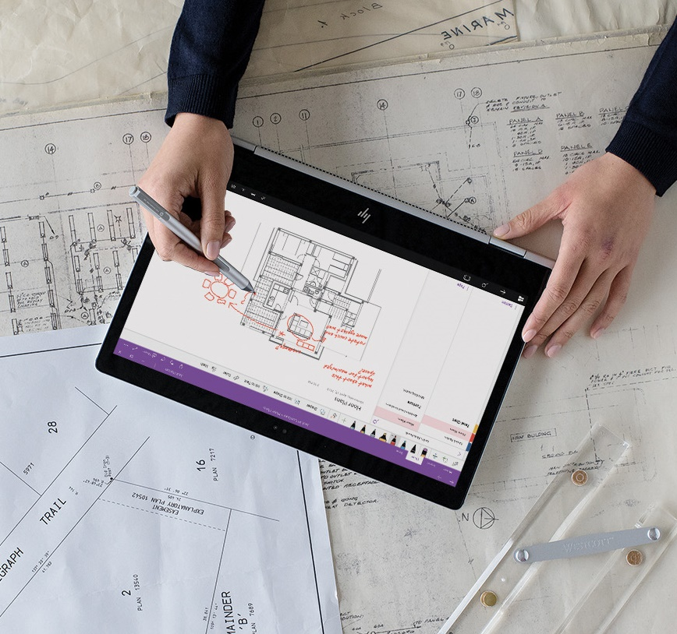


Lesson
Azure Data Lake Storage
Notes:
Instructor notes
This space has been left deliberately blank

Slide 2
What is a Data Lake?
“A storage repository that holds a vast amount of raw data in its native format, including structured, semi-structured, and unstructured data.” Tamara Dull
Data is stored usually as blobs or files
“If you think of a Data Mart as a store of bottled water – cleansed and packaged and structured for easy consumption – the Data Lake is a large body of water in a more natural state.
The contents of the Data Lake stream in from a source to fill the lake, and various users of the lake can come to examine, dive in, or take samples.” James Dixon

Slide 3
Azure Data Lake Storage (Gen 2)
Based on Blob Storage
Provides a repository where we can upload and store huge amounts of unstructured data with an eye toward high-performance Big Data Analytics
ADLS is a comprehensive, highly scalable, and cost-effective data lake solution for big data analytics built in Azure.
Combines the power of a high-performance file system, with a massive storage platform to help you quickly identify insights in your data.

Slide 4
Data Lake
Great complement for a data warehouse. You may choose to implement a data lake ALONGSIDE your warehouse
Lambda Architecture vs kappa Architecture (Course DP-201)
Batch layer
Speed Layer (Stream)
Serving Layer

Slide 5
Data Lake
Azure Blob Storage vs. Azure Data Lake Storage
If your use case is to store data without performing analysis on the data, then use Azure Blob Storage.
A great use case for blob storage is archiving rarely used data or storing website assets such as images and media.
If you are performing analytics on the data, then you should use Azure Data Lake Storage Gen2

Slide 6
Compare Azure Blob Storage and Data Lake Store Gen 2
Azure Blob
Flat Namespace
Data Lake (Gen II)
Hierarchical Namespace
Notes:
Instructor notes
The black dot represents the root or parent folder in the hierarchy, and blue dots represent different type of data. It is a conceptual image and not meant to be specific. The key point to take away is that there is only one level in a flat namespace, a multiple hierarchy in a hierarchical namespace. This enables the quick traversal of data that suits big data analytics

Slide 7
Hierarchical namespace
Allows the collection of objects/files within an account to be organized into a hierarchy of directories and nested subdirectories in the same way that the file system on your computer is organized.
With the hierarchical namespace enabled, a storage account becomes capable of providing the scalability and cost-effectiveness of object storage, with file system semantics that are familiar to analytics engines and frameworks.

Slide 8
When to enable the hierarchical namespace
For workloads that are designed for file systems that manipulate directories.
This includes all workloads that are primarily for analytics processing.
Datasets that require a high degree of organization will also benefit by enabling the hierarchical namespace.
Improvements in workload latency due to storage acceleration will require compute resources for less time.
Latency for many workloads may be improved due to atomic directory manipulation that is enabled by the hierarchical namespace.
In many workloads, the compute resource represents > 85% of the total cost and so even a modest reduction in workload latency equates to a significant amount of TCO savings.
Even in cases where enabling the hierarchical namespace increases storage costs, the TCO is still lowered due to reduced compute costs.

Slide 9
Optimize ADLS Gen2 for Performance
File size
Organize your data into larger sized files for better performance
Have a "cooking" process that generates larger files to use for downstream applications.
Organizing time series data in folders
Place their files structured by date:
\DataSet\YYYY\MM\DD\datafile_YYYY_MM_DD.tsv

Slide 10
Data Lake - Stages for Processing Big Data
Ingestion: acquire source data
Files, logs, and other types of unstructured data.
Batch movement: Azure Data Factory
Real-time ingestion: Apache Kafka for HDInsight, Stream Analytics, etc.
Store: Azure Data Lake Storage Gen 2.
Prep & Train: perform data preparation and model training
Azure Databricks
Machine Learning Services.
Model & Serve
Involves the technologies that will present the data to users.

Slide 11
Big Data Use Cases
Let’s examine three use cases for leveraging an Azure Data Lake Store
Modern Data Warehouse
This architecture sees Azure Data Lake Storage at the heart of the solution for a modern data warehouse. Using Azure Data Factory to ingest data into the Data Lake from a business application, and predictive models built in Azure Databricks, using Azure Synapse Analytics as a serving layer.
Advanced Analytics
In this solution, Azure Data factory is transferring terabytes of web logs from a web server to the Data Lake on an hourly basis. This data is provided as features to the predictive model in Azure Databricks, which is then trained and scored. The result of the model is then distributed globally using Azure Cosmos DB, that an application uses.
Real Time Analytics
In this architecture, there are two ingestion streams. Azure Data Factory is used to ingest the summary files that are generated when the HGV engine is turned off. Apache Kafka provides the real-time ingestion engine for the telemetry data. Both data streams are stored in Data Lake store for use in the future.
https://azure.microsoft.com/en-us/solutions/data-warehouse/
Notes:
Instructor notes
Listed, are the three core bug data use cases that are largely managed by Data Engineers. You will note that the use cases are not industry specific, rather that they are based on common workload patterns

Slide 12
Data Lake
Be aware of
Data of Governance
https://devblogs.microsoft.com/azuregov/azure-data-lake-storage-gen2-on-azure-government/
Data swamp / graveyard
https://www.information-age.com/data-swamp-data-lake-123481597/
https://www.aiddata.org/blog/avoiding-data-graveyards-how-can-we-overcome-barriers-to-data-use

Slide 13
Data Lake – Useful Links
https://docs.microsoft.com/en-gb/azure/storage/blobs/data-lake-storage-introduction
https://docs.microsoft.com/en-gb/azure/storage/blobs/data-lake-storage-namespace
https://docs.microsoft.com/en-us/azure/active-directory/hybrid/how-to-connect-sync-whatis
https://docs.microsoft.com/en-us/azure/data-lake-analytics/data-lake-analytics-overview
https://docs.microsoft.com/en-us/azure/data-lake-store/data-lake-store-diagnostic-logs
https://docs.microsoft.com/en-us/azure/sql-data-warehouse/sql-data-warehouse-load-from-azure-data-lake-store
https://docs.microsoft.com/en-us/azure/storage/blobs/data-lake-storage-access-control
https://docs.microsoft.com/en-us/azure/storage/blobs/data-lake-storage-performance-tuning-guidance

Slide 14
Data Lake – Extra Advice
https://docs.microsoft.com/en-us/learn/modules/introduction-to-azure-data-lake-storage/
https://channel9.msdn.com/Shows/Azure-Friday/Azure-Data-Lake-Storage-Gen2-overview
https://docs.microsoft.com/en-us/azure/sql-data-warehouse/sql-data-warehouse-load-from-azure-data-lake-store
https://docs.microsoft.com/en-us/azure/storage/blobs/data-lake-storage-performance-tuning-guidance
https://www.sqlchick.com/entries/2016/7/31/data-lake-use-cases-and-planning
https://www.jamesserra.com/archive/2014/12/the-modern-data-warehouse/
https://www.jamesserra.com/archive/2017/12/is-the-traditional-data-warehouse-dead/
https://www.kdnuggets.com/2015/09/data-lake-vs-data-warehouse-key-differences.html
https://towardsdatascience.com/a-brief-introduction-to-two-data-processing-architectures-lambda-and-kappa-for-big-data-4f35c28005bb

Slide 15
Notes:
Instructor notes
This space has been left deliberately blank

